Slide 1
SEMAFOR
Semantic Analysis of Frame Representations

Slide 2
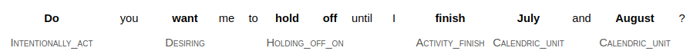
What is SEMAFOR
SEMAFOR is a tool for automatic analysis of the frame-semantic structure of English text.
Parse text to find words that evoke frames.
Identify the arguments of evoked frame that will fill a role associated with the frame.
Input: Text file (one sentence per line)
Output: XML / JSON file
Example:

Slide 3
What is Framenet
Lexical database of English based on how words are used in actual texts.
Groups predicates in a hierarchy of structured concepts, known as frames.
More than 200,000 manually annotated sentences linked to more than 1,200 semantic frames.
Applications:
semantic role labeling, information extraction, machine translation, sentiment analysis.
Example:
https://framenet.icsi.berkeley.edu/fndrupal/frameIndex

Slide 4
Frame extraction procedure
Preprocessing
Target Identification
Frame Identification
Argument Identification
Output

Slide 5
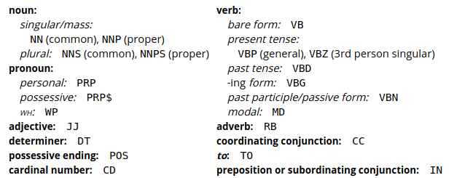
Part-of-speech tagging
Designate syntactic properties with words in the sentence.

Slide 6
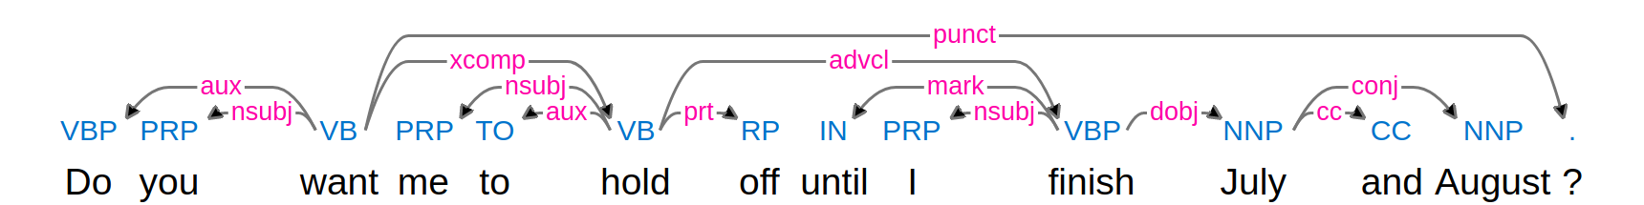
Dependency parse
Identify dependency and structure of sentence.
Binary relations between tokens.
nsubj (nominal subject), dobj (direct object), iobj (indirect object), aux (auxiliary verb), prep (prepositional phrase), pobj (object of preposition), det(determiner), nn (noun compound modifier), amod (adjectival modifier), advmod (adverbial modifier), and punct (punctuation)

Slide 7
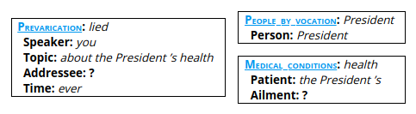
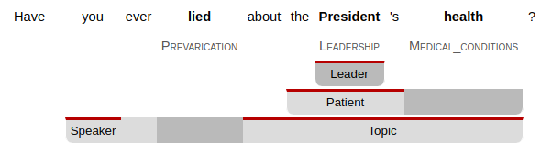
Frame-Semantic Parse
Example: Have you ever lied about the President’s health?
Frames Evoked:
Arguments:

Slide 8
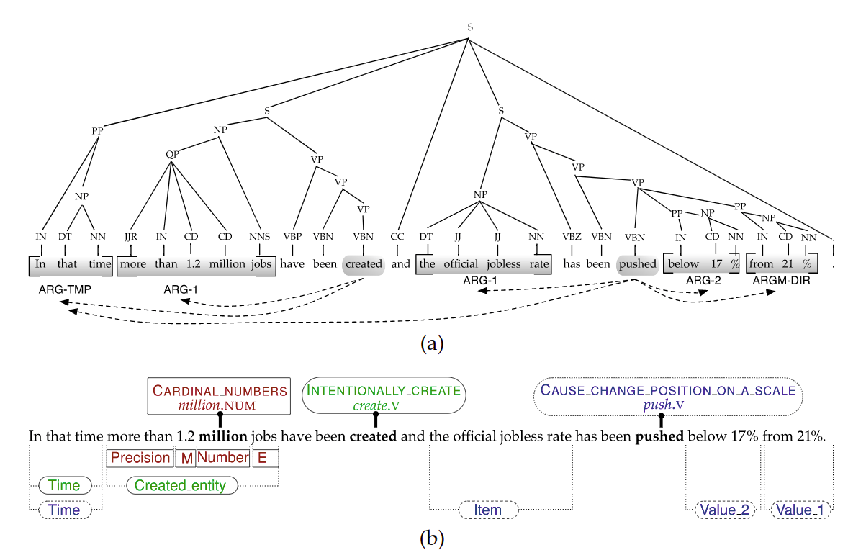
Another example:

